Slide 1
Triangle Tan Product and Sum
Inspired by a problem in
“Introducing Pure Mathematics” (Smedley and Wiseman, 2nd edition) Ex 15A Q23, p363

Slide 2






Triangle Tan Product and Sum
Find the ratio $\frac{\tan{A}\tan{B}\tan{C}}{\tan{A}+\tan{B}+\tan{C}}$ for the triangle shown.
$$C$$
$$5$$
$$2$$
$$B$$
$$4$$
$$A$$
(not to scale)

Slide 3






Triangle Tan Product and Sum
$$2^{2}=4^{2}+5^{2}−2\left(4\right)\left(5\right)\cos{A}$$
$$\cos{A}=\frac{37}{40}$$
$$\tan{A}=\frac{\sqrt{231}}{37}$$
$$C$$
$$40$$
$$\sqrt{{40}^{2}−{37}^{2}}$$
$$=\sqrt{231}$$
$$A$$
$$5$$
$$2$$
$$37$$
$$B$$
$$4$$
$$A$$
(not to scale)

Slide 4
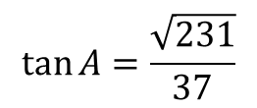






Triangle Tan Product and Sum
$$\tan{A}=\frac{\sqrt{231}}{37}$$
$$5^{2}=4^{2}+2^{2}−2\left(4\right)\left(2\right)\cos{B}$$
$$\cos{B}=\frac{−5}{16}$$
$$\tan{B}=\frac{\sqrt{231}}{−5}$$
$$C$$
$$\sqrt{{16}^{2}−{(−5)}^{2}}$$
$$=\sqrt{231}$$
$$16$$
$$B$$
$$5$$
$$2$$
$$−5$$
$$B$$
$$4$$
$$A$$
(not to scale)

Slide 5



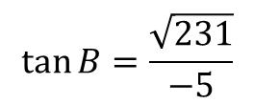


Triangle Tan Product and Sum
$$\tan{A}=\frac{\sqrt{231}}{37}$$
$$\frac{\sin{C}}{4}=\frac{\sin{A}}{2}$$
$$\sin{C}=\frac{4\left(\frac{\sqrt{231}}{40}\right)}{2}=\frac{\sqrt{231}}{20}$$
$$\tan{C}=\frac{\sqrt{231}}{13}$$
$$\tan{B}=\frac{\sqrt{231}}{−5}$$
$$C$$
$$20$$
$$\sqrt{231}$$
$$C$$
$$5$$
$$2$$
$$\sqrt{{20}^{2}−231}$$
$$=13$$
$$B$$
$$4$$
$$A$$
(not to scale)

Slide 6
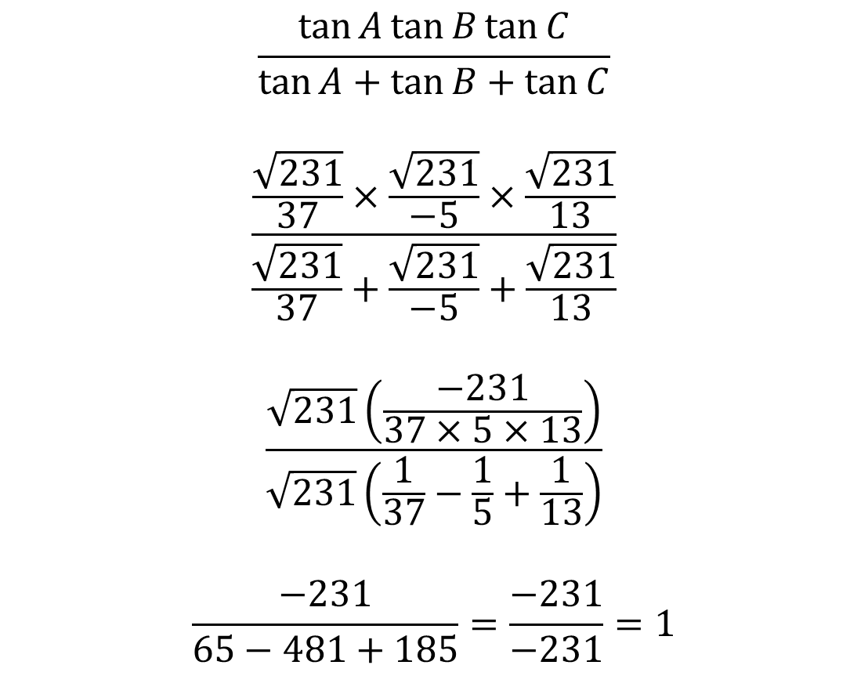
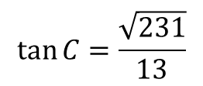
Triangle Tan Product and Sum
$$\tan{A}=\frac{\sqrt{231}}{37}$$
$$\frac{\tan{A}\tan{B}\tan{C}}{\tan{A}+\tan{B}+\tan{C}}$$
$$\frac{\frac{\sqrt{231}}{37}×\frac{\sqrt{231}}{−5}×\frac{\sqrt{231}}{13}}{\frac{\sqrt{231}}{37}+\frac{\sqrt{231}}{−5}+\frac{\sqrt{231}}{13}}$$
$$\frac{\sqrt{231}\left(\frac{−231}{37×5×13}\right)}{\sqrt{231}\left(\frac{1}{37}−\frac{1}{5}+\frac{1}{13}\right)}$$
$$\frac{−231}{65−481+185}=\frac{−231}{−231}=1$$
$$\tan{B}=\frac{\sqrt{231}}{−5}$$
$$\tan{C}=\frac{\sqrt{231}}{13}$$

Slide 7

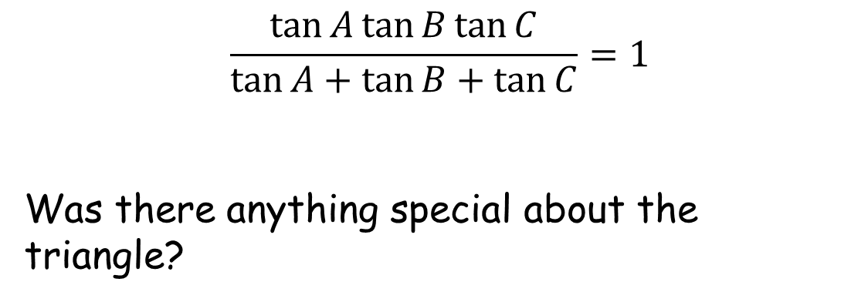
Triangle Tan Product and Sum
$$\tan{A}=\frac{\sqrt{231}}{37}$$
$$\tan{B}=\frac{\sqrt{231}}{−5}$$
$$\frac{\tan{A}\tan{B}\tan{C}}{\tan{A}+\tan{B}+\tan{C}}=1$$
Was there anything special about the triangle?
$$\tan{C}=\frac{\sqrt{231}}{13}$$
$$C$$
$$5$$
$$2$$
$$B$$
$$4$$
$$A$$
(not to scale)

Slide 8

Triangle Tan Product and Sum
Look at the general case.
$$C$$
$$B$$
$$A$$

Slide 9
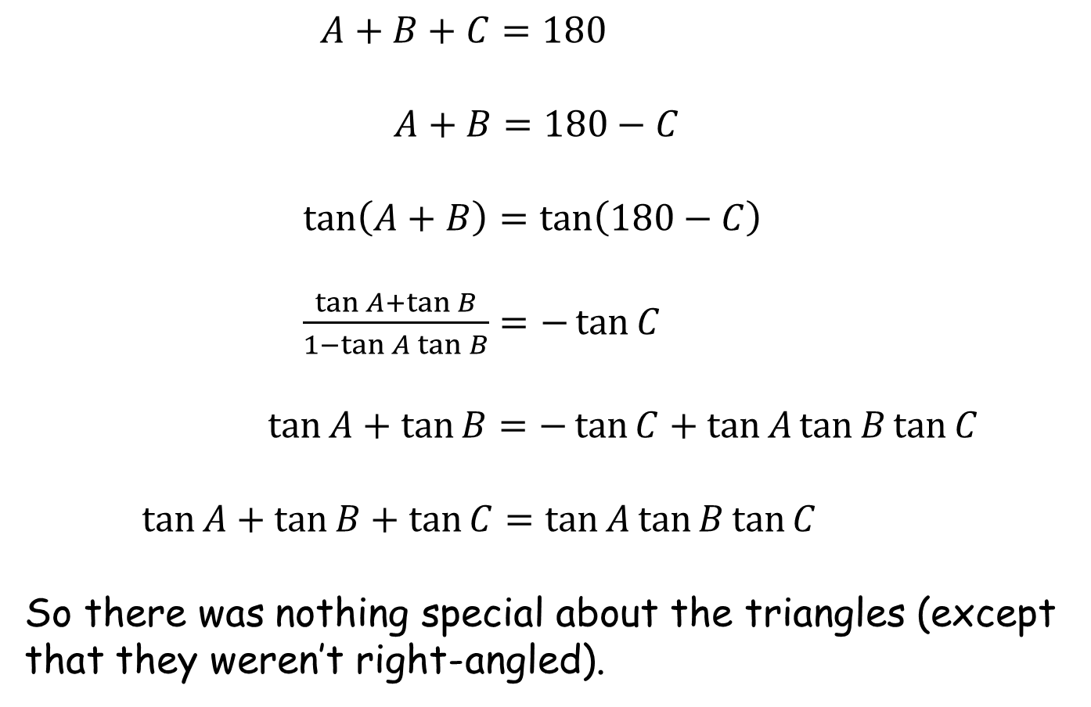
Triangle Tan Product and Sum
$A+B+C=180$
$A+B=180−C$
$\tan\left(A+B\right)=\tan\left(180−C\right)$
$\frac{\tan{A}+\tan{B}}{1−\tan{A}\tan{B}}=−\tan{C}$
$\tan{A}+\tan{B}=−\tan{C}+\tan{A}\tan{B}\tan{C}$
$\tan{A}+\tan{B}+\tan{C}=\tan{A}\tan{B}\tan{C}$
So there was nothing special about the triangles (except that they weren’t right-angled).

Slide 11
RESOURCES

Slide 12





Triangle Tan Product and Sum
Find the ratio $\frac{\tan{A}\tan{B}\tan{C}}{\tan{A}+\tan{B}+\tan{C}}$ for the triangle shown.
$$C$$
$$7.5$$
$$3$$
$$B$$
$$6$$
$$A$$
(not to scale)
SIC_55

Slide 13



Triangle Tan Product and Sum
Find the ratio $\frac{\tan{A}\tan{B}\tan{C}}{\tan{A}+\tan{B}+\tan{C}}$ for the triangle shown.
$$C$$
$$10$$
$$4$$
$$B$$
$$8$$
$$A$$
(not to scale)
SIC_55

Slide 14



Triangle Tan Product and Sum
Find the ratio $\frac{\tan{A}\tan{B}\tan{C}}{\tan{A}+\tan{B}+\tan{C}}$ for the triangle shown.
$$C$$
$$12.5$$
$$5$$
$$B$$
$$10$$
$$A$$
(not to scale)
SIC_55

Slide 15




Triangle Tan Product and Sum
Find the ratio $\frac{\tan{A}\tan{B}\tan{C}}{\tan{A}+\tan{B}+\tan{C}}$ for the triangle shown.
$$C$$
$$6$$
$$2$$
$$B$$
$$5$$
$$A$$
(not to scale)
SIC_55

Slide 16



Triangle Tan Product and Sum
Find the ratio $\frac{\tan{A}\tan{B}\tan{C}}{\tan{A}+\tan{B}+\tan{C}}$ for the triangle shown.
$$C$$
$$8.5$$
$$3$$
$$B$$
$$7$$
$$A$$
(not to scale)
SIC_55

Slide 17


Triangle Tan Product and Sum
Find the ratio $\frac{\tan{A}\tan{B}\tan{C}}{\tan{A}+\tan{B}+\tan{C}}$ for the triangle shown.
$$C$$
$$8$$
$$2$$
$$B$$
$$7$$
$$A$$
(not to scale)
SIC_55

Slide 18

Triangle Tan Product and Sum
Find the ratio $\frac{\tan{A}\tan{B}\tan{C}}{\tan{A}+\tan{B}+\tan{C}}$ for the triangle shown.
$$C$$
$$9.5$$
$$3$$
$$B$$
$$8$$
$$A$$
(not to scale)
SIC_55

Slide 19


Triangle Tan Product and Sum
Find the ratio $\frac{\tan{A}\tan{B}\tan{C}}{\tan{A}+\tan{B}+\tan{C}}$ for the triangle shown.
$$C$$
$$4$$
$$2$$
$$B$$
$$3$$
$$A$$
(not to scale)
SIC_55

Slide 20

Triangle Tan Product and Sum
Find the ratio $\frac{\tan{A}\tan{B}\tan{C}}{\tan{A}+\tan{B}+\tan{C}}$ for the triangle shown.
$$C$$
$$7$$
$$2$$
$$B$$
$$6$$
$$A$$
(not to scale)
SIC_55

Slide 21


Triangle Tan Product and Sum
Find the ratio $\frac{\tan{A}\tan{B}\tan{C}}{\tan{A}+\tan{B}+\tan{C}}$ for the triangle shown.
$$C$$
$$11$$
$$4$$
$$B$$
$$9$$
$$A$$
(not to scale)
SIC_55

Slide 22

Triangle Tan Product and Sum
Find the ratio $\frac{\tan{A}\tan{B}\tan{C}}{\tan{A}+\tan{B}+\tan{C}}$ for the triangle shown.
$$C$$
$$12$$
$$4$$
$$B$$
$$10$$
$$A$$
(not to scale)
SIC_55

Slide 23



Triangle Tan Product and Sum
Find the ratio $\frac{\tan{A}\tan{B}\tan{C}}{\tan{A}+\tan{B}+\tan{C}}$ for the triangle shown.
$$C$$
$$13$$
$$4$$
$$B$$
$$11$$
$$A$$
(not to scale)
SIC_55

